Slide 1

TITLE IX
AT MSU
Lateshia Butler, Mississippi State University
October 2025

Slide 2
The basic structure of federal sexual misconduct laws
In higher ed, 2011-2019
LESS SPECIFIC MORE SPECIFIC
STATUTES
TITLE IX (1972)
CAMPUS SAVE ACT/VAWA
CLERY ACT
CASE LAW
GEBSER (1998) and DAVIS (1999)
GUIDANCE
2011 DEAR COLLEAGUE LETTER
2014 DEAR COLLEAGUE LETTER
RESOLUTION AGREEMENTS

Slide 3
The basic structure of federal sexual misconduct laws
In higher ed, 2025
LESS SPECIFIC MORE SPECIFIC
STATUTES
TITLE IX (1972)
CAMPUS SAVE ACT/VAWA
CLERY ACT
CASE LAW
GEBSER (1998) and DAVIS (1999)
REGULATIONS
2020 Trump DOE Regulations
2022 Biden Admin. Amendments
(34 C.F.R. 106)
Return to 2020 Trump DOE Regulations

Slide 4
TRAINING REQUIREMENTS
It is essential that every participant in MSU’s Title IX process carefully review Operating Policy 3.04 on Sexual Misconduct, as that document provides the authoritative statement of standards, policy, and procedure.
If you have questions about the contents of the policy, please do not hesitate to contact the Title IX Coordinator, Lateshia Butler at 662-325-5839 or Lateshia.butler@msstate.edu.

Slide 5

Office of Civil Rights Compliance
New independent office overseeing all civil rights functions: Title IX, EEO, ADA
Website: civilrights.msstate.edu
Phone: 662-325-5839
Email: titleix@msstate.edu

Slide 6

TITLE IX INVESTIGATIONS
LATESHIA BUTLER
MISSISSIPPI STATE UNIVERSITY
OCTOBER 2025

Slide 7
BASIC steps for an investigation
NOTICE
SUPPORTIVE MEASURES
Title IX Coordinator “Official with Authority” learns of alleged sexual harassment
Institution offers complainant non-punitive support, potentially including alterations to schedules, counseling, no-contact orders. These must be offered and provided regardless of whether a formal complaint is filed, and irrespective of the outcome of any hearing. They may be temporary, or may last as long as needed.
FORMAL COMPLAINT
INITIAL INVESTIGATION
JURISDICTIONAL
DECISION
INVESTIGATIVE REPORT
HEARING
APPEAL
A live, recorded hearing before a trained adjudicator, with direct cross-examination by advocates, at which determination of outcome is made
Review of hearing result by impartial party, either for procedural errors or newly discovered evidence
Written complaint is submitted, signed by complainant or TIX Coordinator
Initial notifications and meetings with accused party, witnesses; gathering of any documentary or other evidence
Determine whether matter falls within the scope of Title IX, and if not, under what procedures (if any) will it be investigated and adjudicated
Written report by investigator(s) summarizing all relevant evidence, including evidence institution does not intend to present at hearing

Slide 8
TITLE IX COMPLIANCE PERSONNEL, Part 1
Title IX Coordinator: “Coordinates [institution’s] efforts to comply with […] responsibilities” under Title IX and regulations.
  Must contact complainant, receive formal complaints, and authorize any investigations where the complainant does not participate.
  Must ensure procedural requirements for investigation/adjudication (e.g., proper notice, sufficient time) are followed.
  Must coordinate supportive measures.
  May or may not serve as investigator, oversee investigation process, and/or prepare mandatory investigative report.
  May not serve as adjudicator or fact-finder in hearing, or make ultimate decisions on responsibility/non-responsibility.
Officials With Authority To Institute Corrective Measures (OWA’s): Any official, other than the Title IX Coordinator, who has authority under your institution’s policies to institute corrective measures (such as discipline, no-contact orders, or other interim measures) in response to harassment.
  Must relay information suggesting sexual harassment to the Title IX coordinator, as the OWA’s knowledge is imputed to the institution.
Investigators: Responsible for interviewing witnesses, collecting evidence, and preparing investigation report before hearing.
  May or may not also function as Title IX Coordinator.
  May not serve as an adjudicator.

Slide 9
TITLE IX COMPLIANCE PERSONNEL, Part 2
Advocates: Institutions are required to make available to the complainant and respondent an advisor at the live hearing.
  Must conduct cross-examination of the opposing party.
  May or may not be made available prior to hearing. (At MSU, they are.)
  May or may not be an attorney.
“Decision-Makers”: Responsible for deciding the ultimate question of responsibility or non-responsibility at a live, recorded hearing, and for determining disciplinary sanctions.
  Must make determinations as to the permissibility of cross-examination questions,and explain rationale for excluding any question.
  Must make final determination, with assistance from investigation memorandum, on admissibility of evidence.
  Must prepare a written determination explaining result of hearing, including responsibility/non-responsibility, procedural steps in investigation, findings of fact, application of fact to institution policies, disciplinary sanctions, and appeal procedures.
  May be a single individual or a panel. (At MSU, normally an individual.)
  Must not be the same person as Title IX Coordinator or investigator.
Appellate Decision-Makers
  Must review appeals by complainants or respondents for procedural errors or new evidence that could not have previously been presented.
  May not be the same person as Title IX Coordinator, investigator, or original decision maker.

Slide 10
TITLE IX SEXUAL HARASSMENT
TITLE IX SEXUAL HARASSMENT: Conduct on the basis of sex that falls within one or more of three categories:
Quid Pro Quo Harassment: When an employee conditions the provision of an aid, benefit, or service of the College on an individual’s participation in unwelcome sexual conduct
Hostile Environment Harassment: When conduct on the basis of sex is sufficiently severe, pervasive, and objectively offensive, as determined by a reasonable person, that it effectively denies a person equal access to programs or activities.
  Objective and Subjective Requirements: The complainant must actually be subjectively offended AND the conduct must by judged by an objective “reasonable person” standard to be offensive.
  Severe or Pervasive: Another objective standard. Some actions, such as groping or direct insults or threats, may be harassment despite happening only one time, if a reasonable person could determine that one instance is “pervasive enough” to deny equal access. NOTE that this requirement only applies to Hostile Environment Harassment. Offenses like sexual assault and domestic violence need not meet the “severe and pervasive” requirement.
Sexual Violence: Sexual assault, domestic violence, dating violence, or stalking, as defined by policy.
MSU’s “Program or Activity”: Sexual Harassment meets this definition if it occurs at any campus or facility operated by the University, or in connection with any program or activity of the University. Sexual misconduct that does not meet this standard is nonetheless handled under the same MSU policy—OP 3.04—with a few specific variations.

Slide 11
SEXUAL VIOLENCE
Sexual Assault: Any sexual act directed against another person, forcibly and/or against that person’s will (or not forcibly/against will where the victim is incapable of giving consent).
  “Sexual conduct is considered to be against a person’s will where that person has not given consent as defined in this policy.”
  “Sexual conduct is considered forcible where it occurs by means of physical force or coercion as defined in this policy.”
Domestic Violence: Any felony or misdemeanor crime of violence committed by a current or former spouse or intimate partner of the victim, co-parent of a child, cohabiting person, or similarly situated person.
  In Mississippi, Simple Domestic Assault applies to anyone in the above groups who “attempts to cause or purposely, knowingly or recklessly causes bodily injury to another; or (b) negligently causes bodily injury to another with a deadly weapon or other means likely to produce death or serious bodily harm; or (c) attempts by physical menace to put another in fear of imminent serious bodily harm.” So it’s pretty broad.
Dating Violence: Physical violence against a person who does not meet the Domestic Violence definition, but is or has been in a romantic or intimate relationship with the victim, as determined by (1) length of relationship; (2) type of relationship; and (3) frequency of interaction.
Stalking: A course of conduct (based on sex) directed at a specific person that would cause a reasonable person to fear for his or her safety, or the safety of others, or suffer substantial emotional distress.

Slide 12
SEXUAL MISCONDUCT
Sexual Harassment is unwelcome conduct of a sexual nature that is sufficiently severe, pervasive, or persistent that it denies or limits or is likely to deny or limit a reasonable person’s ability to participate in or benefit from university programs, services, opportunities or activities. Does not include First Amendment protected expression.
Sexual Assault refers to rape or other intentional physical sexual acts perpetrated against a person without their consent. Sexual assault includes sexual penetration or intercourse or any other physical contact of a sexual nature that occurs without consent. This includes but is not limited to deliberate physical touching as well as contact of a sexual nature with an object. Sexual assault also includes attempts to induce sexual activity via direct threats of physical violence, even where no physical contact ultimately occurs.
Sexual Exploitation refers to taking sexual advantage of another person in a way that deliberately infringes on his or her reasonable expectation of privacy and/or security, but does not involve actual or attempted physical contact.
Dating/Domestic Violence refers to acts of physical violence, or threats of physical violence, committed by a person who is or has been in a social relationship of a romantic or intimate nature with the victim.
Stalking refers to engaging in a course of conduct (based on sex) directed at a specific person that would cause a reasonable person to fear for their safety or suffer substantial emotional distress.

Slide 13
CONSENT, FORCE & COERCION
CONSENT refers to words or actions that clearly show an active, knowing, and voluntary agreement to engage in a particular sexual activity.
  Determined objectively: Would a reasonable person observing the encounter interpret words/actions as agreement?
  May be withdrawn at any time by clear words or actions.
  Silence or the absence of resistance by themselves are not consent.
  Consent with one person is not consent to sexual activity with another.
  Incapacity prevents a person from giving effective consent, but mere impairment does not.
  A person under the age of consent cannot give effective consent, no matter what.
PHYSICAL FORCE refers to physical contact with any person, by means of one’s own body or an object, for the purpose of causing bodily harm or injury, or of forcibly constraining movement.
  Blocking exit is a form of physical force, even is no actual contact is made.
  Verbal threats of physical force can also preclude consent.
COERCION is threatening an adverse consequence that is not physical force, but is nonetheless severe enough as to prevent a reasonable person from exercising free will in the decision whether to consent.

Slide 14
INVESTIGATOR’S ROLE
Your job as an investigator is to conduct an impartial investigation, collect the relevant facts—whether they support guilt or innocence—and summarize what you have found fairly and objectively for the Title IX Coordinator.
You may not serve either as an advocate for a party or as an adjudicator. That would constitute a conflict of interest.
You must strive to be unbiased. If you feel you have a bias for or against an individual, a group, or a general side (complainants/respondents), you must let the Title IX Coordinator know and recuse yourself.
Being unbiased doesn’t mean you don’t draw conclusions. While the ultimate outcome is decided by an adjudicator, you may be asked to draw conclusions about relevance, credibility, and other issues in some situations—for example, in helping the Coordinator prepare the Investigative Report. Your conclusions must be based on a fair and objective assessment of the evidence.

Slide 15
INVESTIGATION OVERVIEW
Burden on Institution: “The burden of proof and the burden of gathering evidence sufficient to reach a determination regarding responsibility rests on the recipient and not on the parties.” (106.45(b)(5)(i))
You cannot simply ask the parties to provide all relevant evidence, as they may not know what that means. However, you generally cannot compel cooperation, which means the parties bear the responsibility of providing information that they are in the best position to know or provide.
Try to ask more specific questions:
  Are there texts, social media messages, emails?
  Are there names of witnesses? People who were there shortly beforehand or shortly after? People to whom the parties described the events very shortly after they happened?
Where relevant, you should independently follow up on leads—e.g., locations that might have security footage if there is reason to believe it may reveal pertinent information.
You are not required to be perfect, or be law enforcement, but you must make a good faith effort.

Slide 16
INVESTIGATION PROCEDURE
Advance notice: Parties must be informed in writing of all meetings of any kind related to the investigation, including investigative interviews. This means “date, time, location, and purpose.” Notice must be sufficiently early to allow “sufficient time for the party to prepare.” Under new regulations, this means at least 24 hours in advance.
Advisors: Parties must be informed in writing of their right to be accompanied to all meetings by an advisor of their choice.
You may not impose “gag orders.”
  Students and employees are free to discuss matters and seek relevant information or evidence from others.
  However, intimidation, threats or any other action that would deter a reasonable person from participating in an investigation is retaliation, and can be sanctioned.
  One obvious exception is communication between the complainant and respondent. If the institution has implemented a no-contact order, which is common, this must be followed.
Parties must be permitted to view the evidence collected. This normally occurs through the pre-hearing report, but they may also request to review it sooner via written request to the Title IX Coordinator. The general rule is, try to be as evenhanded as possible given the particular facts of the case.
Basic Rule of Thumb: If you are at all in doubt, call the Title IX Coordinator.

Slide 17
INVESTIGATION TIPS
The default order for investigation usually looks something like:
  Receive formal complaint and provide written notices.
  Interview complainant.
  Interview respondent.
  Based on initial interviews (1) gather any documentary evidence; (2) identify and schedule interviews of potential witnesses.
  Interview potential witnesses.
  After reviewing documentary evidence and witness interviews, re-interview complainant and then respondent. This interview should focus on identifying any inconsistencies or potential weaknesses and giving parties an opportunity to address them.
The timeline for investigation and adjudication is now “reasonably prompt”, which provides some flexibility. But a good rule of thumb is no more than 45 days from the initial interview to sitting down to the initial draft of the investigation report.
Where possible, interviews should either be witnessed by an additional institution employee or be recorded. Parties do change their stories, and you need to be able to verify what was said. There may be some exceptions, such as follow-up interviews to clear up minor details.
Strong note-taking is important. Notes should be accurate and fair. Pause the interview as needed to make sure you are getting all relevant information.
Be transparent with the parties. In some cases, an investigator may need to convey the opposing party’s strongest position will be, and give the interviewee an opportunity to respond. This will help you uncover red herring issues and focus on the points and evidence that matter.

Slide 18
INVESTIGATION TIPS
As an investigator, your role is neither prosecutor nor defense counsel. You are an objective and impartial fact-gatherer.
Personal experiences, biases, or empathy cannot change the way you approach an investigation.
It is possible to balance compassion and investigative rigor. During initial interviews, the best approach is to allow each party to tell their story in the manner they see fit, then to follow up with specific questions to fill in details.
Interviews generally should not be games of “gotcha,” in which investigators try to catch parties in contradictions.
If a statement seems inconsistent or contradicted by evidence, the best practice is to tell the interviewee your concern and give them an opportunity to provide an explanation. If a story doesn’t hold together, that will become clear in time without the need for aggressive interrogation.
Understand that both parties likely are under great stress. Provide ample time for them to answer, and understand that brief confusion or lack of recollection is not, in itself, evidence of fabrication.
However, the mere fact that a party cannot recall information or has trouble recounting events should not be viewed as evidence of trauma suggesting that sexual violence occurred.

Slide 19
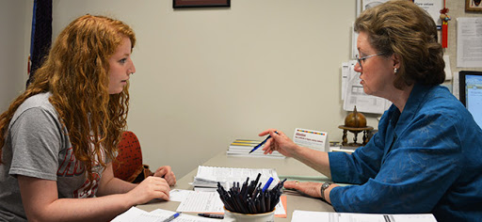
TITLE IX
ADVISING
LATESHIA BUTLER
MISSISSIPPI STATE UNIVERSITY
OCTOBER 2025

Slide 20
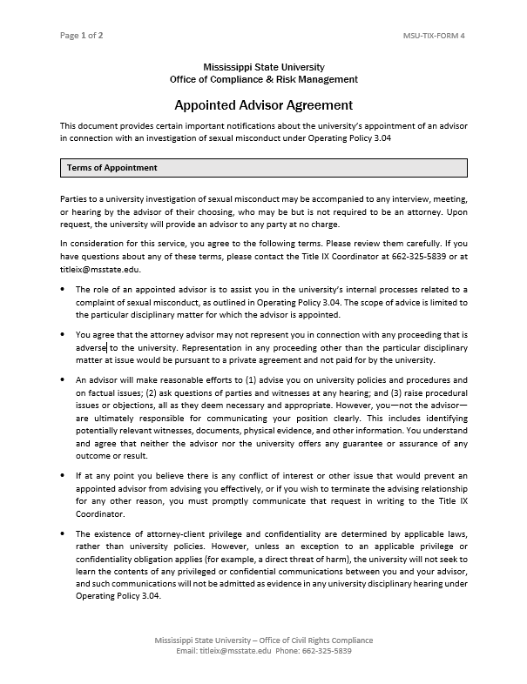
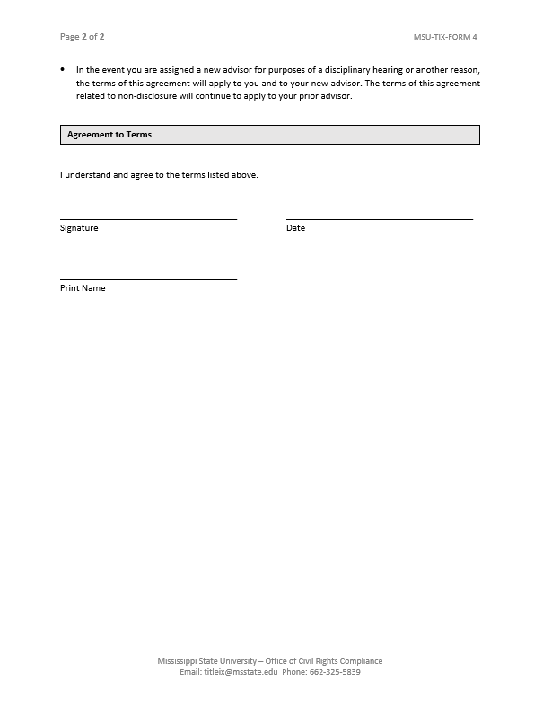
Appointed Advisor Agreement:
No assurance of result or outcome, only reasonable effort to advise.
Party is ultimately responsible for presenting their position.
No position on attorney-client privilege, but MSU will never seek to discover communications.
No representation adverse to university.

Slide 21
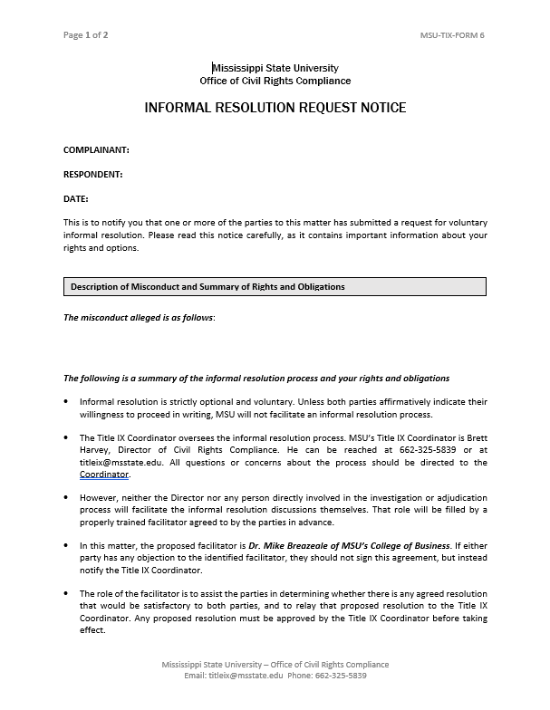
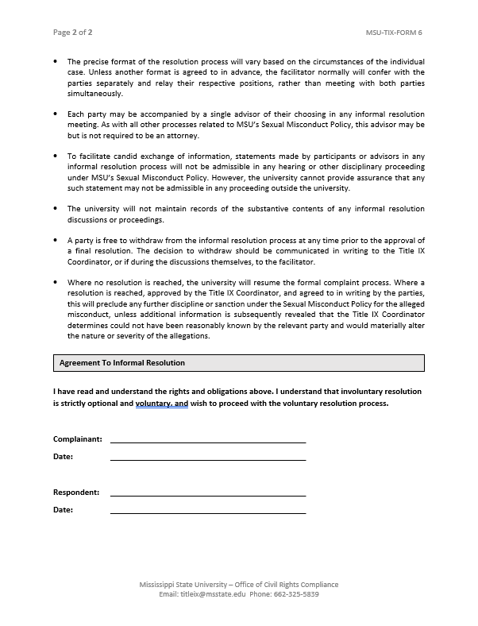
INFORMAL RESOLUTION
This now is an option for sexual assault cases by mutual agreement of parties.
Never for cases where faculty/staff are the respondent.
Conducted by impartial mediator unaffiliated with OCRC.
Just wanted our advisors to be aware this is an option.

Slide 22
THE ADVISOR’S ROLE
At MSU, an appointed advisor’s role is to advise the party—complainant or respondent—on issues related to MSU policy and procedure, as well as assisting the party in identifying potentially relevant evidence or issues and presenting them to the investigator or adjudicator.
An advisor may be present for any meeting, interview, or hearing in MSU’s process, at the discretion of the party. It is the responsibility of the party to ensure their advisor’s availability.
And advisor may raise procedural questions or objections at any point to the Title IX Coordinator.
The ultimate responsibility for presenting arguments and positions lies with the party; the advisor’s role is to suggest possible alternatives, but they have neither the power nor the responsibility to compel a party to take any particular approach.
An advisor’s communications with a party are confidential with respect to MSU’s process, but MSU cannot guarantee that communications will be privileged against external discovery.
An advisor is not expected to be impartial—their duty is to advocate for the party they are assigned to. However, the advisor is expected to behave professionally at all times and to adhere to all rules and procedures outlined in OP 3.04.

Slide 23
ADVISING CONSIDERATIONS
Taking inventory of relevant evidence. Texts, emails, social media messages, possible security camera footage or card swipes.
Taking inventory of potential witnesses. Witnesses to the actual event, individuals present shortly before or after the event, witnesses to admissions by the opposing party.
Preparing the party to state their position clearly to investigators.
Considering possible informal resolution. This is never required, but parties may wish to explore it as an option.
Considering the ramifications of possible parallel criminal or civil proceedings.
When to consider admission of responsibility or voluntary withdrawal of complaint.

Slide 24
HEARING ADVISORS
In many instances, this portion of advising will be handled by a different individual than the initial investigation. The hearing advisor should therefore coordinate with the investigation advisor to be sure all relevant information about the case is communicated.
The hearing advisor is responsible for cross-examination of opposing parties and witnesses at the hearing and should prepare accordingly.
The hearing advisor also may raise procedural issues or objections at the hearing.
The advisor does not present testimony. Generally, it is the duty of the party to speak on factual issues, although the adjudicator does have discretion to consider explanations from the advisor when he or she determines they may be helpful.
The hearing advisor will assist a party receiving an adverse outcome in any internal appeal process.

Slide 25

TITLE IX ADJUDICATION
LATESHIA BUTLER
MISSISSIPPI STATE UNIVERSITY
OCTOBER 2025

Slide 26
THE ADJUDICATOR’S ROLE
The adjudicator oversees the live hearing and renders the university’s decision as to responsibility or non-responsibility.
The adjudicator is assisted by the Title IX Coordinator, who may offer opinions and advice on procedural questions or explanations of the contents of the Investigation Report, but may not offer opinions on the ultimate merits of the matter.
The adjudicator may not serve as an investigator or advocate, and may not serve as an appellate adjudicator in the same matter he or she heard in the first instance.
The adjudicator must be impartial and fair, and weigh all relevant evidence, both inculpatory and exculpatory. If an adjudicator has a bias toward any individual, group, or type of party (e.g., complainants or respondents) they must disclose this immediately and recuse.
The adjudicator has discretion to conduct the live hearing as he or she deems fit, but must provide both parties equal and fair opportunity to present relevant evidence.
Finally, the adjudicator is responsible for writing an opinion explaining the basis for the outcome of the hearing.

Slide 27
THE Investigative Report
The investigative report is prepared by the Title IX Coordinator in conjunction with the investigator.
It summarizes all relevant evidence, both inculpatory and exculpatory, and is provided to the parties and the adjudicator(s).
What is “relevant evidence”?
  Federal regulations say the word “relevant” should be defined consistent with its “ordinary meaning.” (p. 811, n.1018)
  This does not permit exclusion based on other factors like undue prejudice or cumulative evidence, which would be consider by a court evaluating whether to admit evidence.
  The simplest approach may be to ask: “Does this evidence make any fact material to the ultimate outcome more or less likely to be true?” If so, it should be included in the investigative report, even if the report ultimately suggests that its impact on the ultimate decision is low.
The report may or may not include recommended findings or conclusions, but the decision-maker is obliged to make an independent, objective determination based on relevant evidence.

Slide 28
THE Live Hearing
Regulations require a “live hearing”.
  At this hearing, the “decision-maker(s) must permit each party’s advisor to ask the other party and any witnesses all relevant questions and follow-up questions, including those challenging credibility.” (106.46(b)(6))
  Direct Cross-Examination: “Cross-examination must be conducted directly, orally, and in real time by the party’s advisor of choice and never by a party personally.”
  Remote Option: “At the request of either party, the request of either party, the recipient must provide for the live hearing to occur with the parties located in separate rooms with technology enabling the decision-maker(s) and parties to simultaneously see and hear the party or the witness answering questions.”
  Must be recorded, either audiovisual or audio, or transcribed.
Advisors Required: “If a party does not have an advisor present at the live hearing, the recipient must provide without charge or fee to that party, an advisor of the recipient’s choice, who may be but is not required to be an attorney, to conduct cross-examination on behalf of that party.”
  The advocate who assists the party at the hearing often will not be the same person who assisted them in the initial investigation. MSU will facilitate a “hand-off” of the matter from the investigation advisor to the hearing advisor. These two individuals should cooperate to the greatest extent possible to ensure the party receives sufficient advising and advocacy.

Slide 29
THE Live Hearing
The order of the hearing is flexible but typically runs as follows:
Reading of the charge and respondent’s plea
Parties’ opening statements
Complainant’s Testimony and Cross
Respondent’s Testimony and Cross
Witness Testimony and Cross
Any further questions from Adjudicator
Parties’ closing statements
Adjourn to determine sanction and prepare Written Determination.

Slide 30
Relevance of questions and Evidence
Questions: “Only relevant cross-examination and other questions may be asked of a party or witness.” (106.45(b)(6)(i))
“Before a complainant, respondent, or witness answers a cross-examination or other question, the decision-maker(s) must first determine whether the question is relevant and explain any decision to exclude a question as not relevant.”
  We suggest the following approach: (1) The question is asked; (2) the decision maker considers it; (3) the decision maker tells the witness they may or may not respond; and (4) if not, the decision maker briefly explains the rationale for excluding the question.
  Rape Shield Provision: “Questions and evidence about the complainant’s sexual predisposition or prior sexual behavior are not relevant, unless such questions and evidence about the complainant’s prior sexual behavior are offered to prove that someone other than the respondent committed the conduct alleged by the complainant, or if the questions and evidence concern specific incidents of the complainant’s prior sexual behavior with the respect to the respondent and are offered to prove consent.”
Evidence: While the investigation report can make recommendations as to the relevance of evidence (including exhibits and witnesses) the regulations strongly suggest that he decision maker must make final determinations as to what evidence is admissible.
  The simplest approach may be to ask: “Does this evidence make any fact material to the ultimate outcome more or less likely to be true?”
  An adjudicator may admit evidence but assign it little or no weight in a determination.
These real-time decisions are another reason why individual adjudicators, as opposed to panels, may be preferable.

Slide 31
LIVE TESTIMONY – AN UPDATE
“If a party or witness does not submit to cross-examination at the live hearing, the decision maker must not rely on any statement of that party or witness in reaching a determination regarding responsibility; provided, however, that the decision maker cannot draw an inference about the determination regarding responsibility based solely on the party’s or witness’s absence from the live hearing or refusal to answer cross-examination or other questions.” (106.45(b)(6)(i))
This provision is now subject to a nationwide injunction issued by a Massachusetts District Court, holding that the above provision violates the Administrative Procedure Act because it is “arbitrary and capricious.”
Partly because it barred prior inculpatory statements by an absent respondent, and partly because it could “further a disruptive agenda” if a complainant persuaded key witnesses not to attend.
OCR Guidance in August 2021 subsequently clarified that it will immediately cease enforcement of this provision. The guidance specifically notes that adjudicators may now consider, for example, correspondence or statements by absent parties or witnesses
MSU will comply with the injunction while it remains effective. Instead of strictly barring all reference to statements by absent witnesses, adjudicators should apply the normal relevance standard to determine whether statements by absent witnesses or parties are admissible, and normal standards such as credibility in determining their impact on factual determinations.

Slide 32
TESTIMONY – LESSONS Learned
Because the adjudicator is required to make a determination on the relevance of each question, we will be emphasizing the “short delay before answering” in future hearings.
We want to balance the ability of advocates to move efficiently with this rule, so we’ll be insisting on more strict adherence to the requirement that the advocate and party allow the adjudicator time to give a nod or “okay” before answering.

Slide 33
Written Determination
The adjudicator’s written determination must include:
A statement of the allegations considered
A descriptions of the procedural steps from the receipt of the formal complaint (which will be provided in the Investigative Report)
Findings of relevant fact
Conclusions applying relevant MSU policies to facts
A statement of the result for each separate allegation, including any sanction or other remedy and the rational for the same, and
A statement of possible grounds and procedures for appeal.

Slide 34
APPEAL PROCEDURE
An appeal may be made by any party from (1) any pre-hearing dismissal; or (2) the outcome of a hearing.
There are three grounds for appeal: (1) a procedural error that likely affected the outcome of the matter; (2) new evidence that was not reasonably available at the time of the determination or dismissal that likely would affect the outcome of the matter; or (3) evidence or an impermissible conflict of interest or bias on the part of the Title IX Coordinator, investigator, or adjudicator.
A party may appeal by submitting a written notice of appeal to the Title IX Coordinator within seven days of any decision.
The Title IX Coordinator will inform parties of how to submit written statements on appeal.
Appeals involving status as a student are referred to the VPSA. Appeals involving status as an employee are referred to the Provost.
The appellate adjudicator may not have served in any other capacity in connection with the investigation in question.

Slide 35
APPELLATE ADJUDICATION
The appellate adjudicator will receive a packet of materials directly from the Title IX Coordinator. This normally will include:
  The Investigation Report
  The Notice of Outcome
  A recording of the hearing, if applicable
  Any hearing evidence or exhibits
  In cases of pre-hearing dismissal, all relevant materials from the OCRC file.
In appeals from a hearing, the appellate adjudicator will consider ONLY the hearing record, the parties’ written statements, and applicable policies. He or she may not conduct a new hearing or hear new testimony.
In cases of new evidence, the party will make an evidentiary proffer as part of their statement on appeal—i.e., either provide the new evidence or submit a written summary of the new testimony that would be offered.
Except in very rare cases, the appellate adjudicator should not communicate directly with the parties, investigators, or hearing adjudicator.
  One exception might be in cases where there is a factual dispute about the actions of a party or investigator outside of a hearing, such as where there is an allegation of investigator bias. Even in these cases, however, communication should almost always be in writing, via written statements from the appellant and written follow-up questions.

Slide 36
APPELLATE DECISION
The appellate adjudicator may (1) affirm the outcome; (2) reverse the outcome and remand to the hearing adjudicator for further proceedings to determine remaining questions; or (3) if the case leaves no remaining material questions, reverse the outcome and render a new, final outcome.
The appellate adjudicator will issue a written decision explaining the outcome of the appeal and the rationale, which is transmitted to the Title IX Coordinator, who informs the parties simultaneously.
The decision of the appellate adjudicator is final and not subject to further appeal.

